Slide 1
Project 1 : Calculator
Gurpreet kaur
Submission Date: 4 Dec 2024

Slide 2
Project Overview
Objective: Develop a scientific calculator that performs complex mathematical operations, such as
trigonometric functions, logarithms, exponentiation, and statistical analysis.
Key Features:
Basic Operations: Addition, subtraction, multiplication, division.
Advanced Functions: Sine, cosine, tangent, logarithms, square roots, and powers.
User-Friendly Interface: Simple design for easy navigation and use.
Error Handling: Prevents errors from invalid operations or inputs.

Slide 3
Challenges and Solutions
Learning PyQt5 Framework:
Challenge: PyQt5 is a robust but complex framework, and understanding its concepts such as signals, slots,
and widget hierarchy was initially difficult as well as how to install in computer.
Solution: I referred to the official PyQt5 documentation, followed tutorials, YouTube, and practiced by creating small
GUI components before starting the main project.
Designing an Intuitive GUI
Challenge: Aligning buttons, text displays, and other widgets in a visually appealing and functional layout was
tricky, especially when working with PyQt5’s grid layout system.
Solution: I used trial-and-error with QGridLayout and modularized the design process. Tools like Qt Designer were also helpful for visualizing
and refining the interface.

Slide 4
Challenges and Solutions
Implementing Scientific Functions
Challenge: Writing backend logic for scientific operations like trigonometric functions, logarithms, and handling
radians vs degrees required additional research and testing.
Solution: I used Python’s math library for these functions and ensured accurate calculations by rigorously testing edge cases (e.g., sin(90), log(0)).
Handling Errors in Calculations
Challenge: The application often crashed due to user inputs such as dividing by zero or entering invalid operations (e.g., multiple operators in sequence).
Solution: I implemented error handling using try-except blocks and added checks to validate user inputs before processing calculations. Meaningful
error messages were displayed to guide the user.

Slide 5
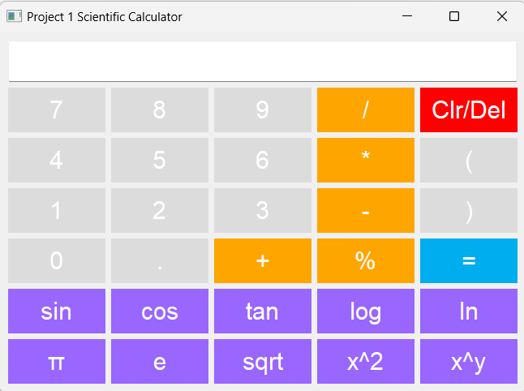
Output Scientific Calculator

Slide 6
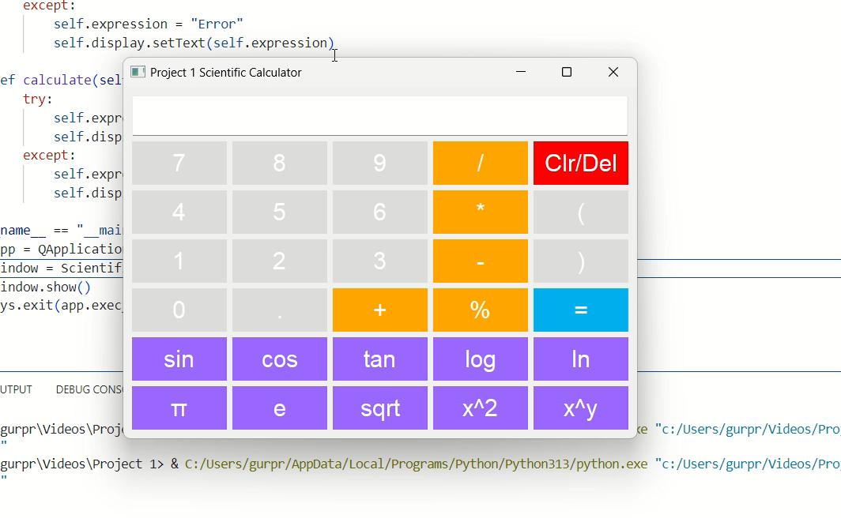
Calculator Working

Slide 7
Thanks You

